Slide 1
Assignment 5 Create a script tool and toolbox with python
Hanqi Li

Slide 2
Create a script tool

Slide 3
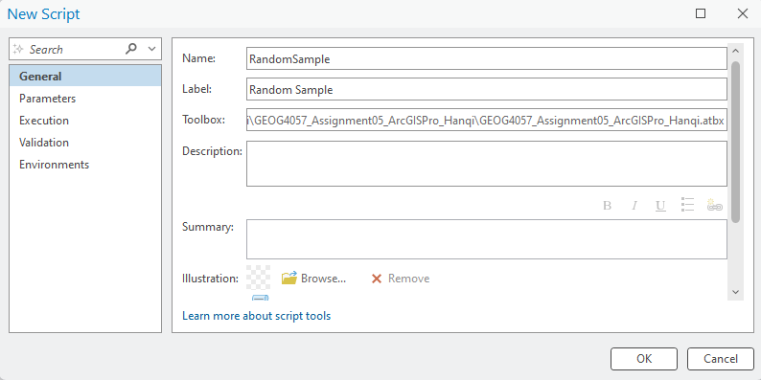

Slide 4
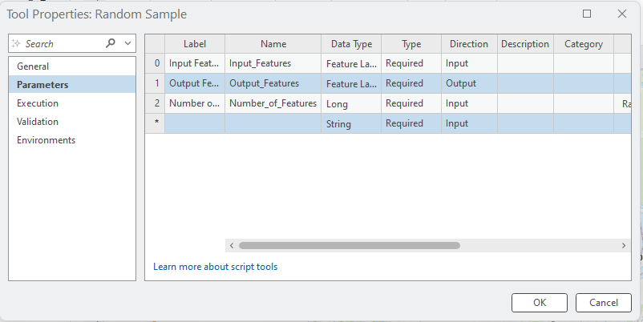

Slide 5
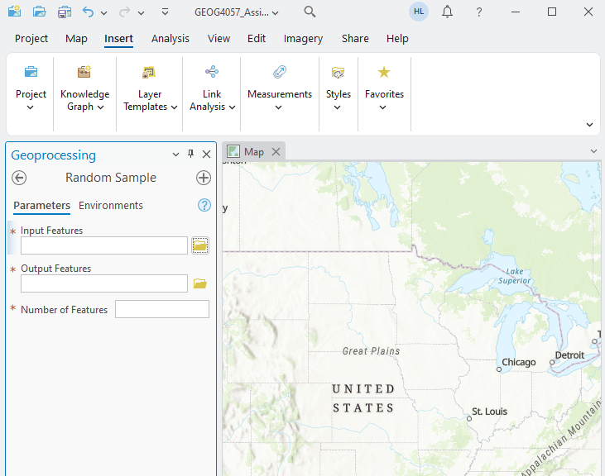

Slide 6
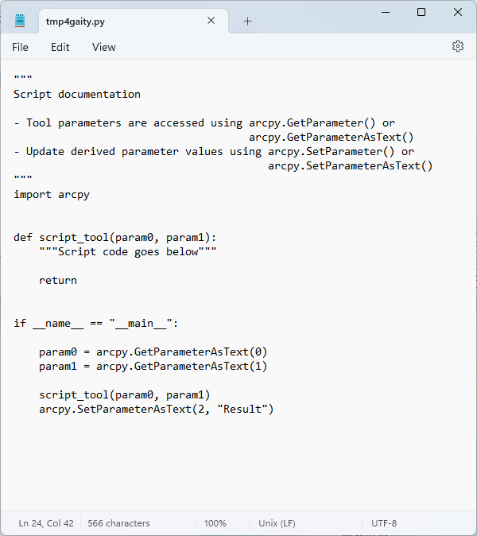

Slide 7
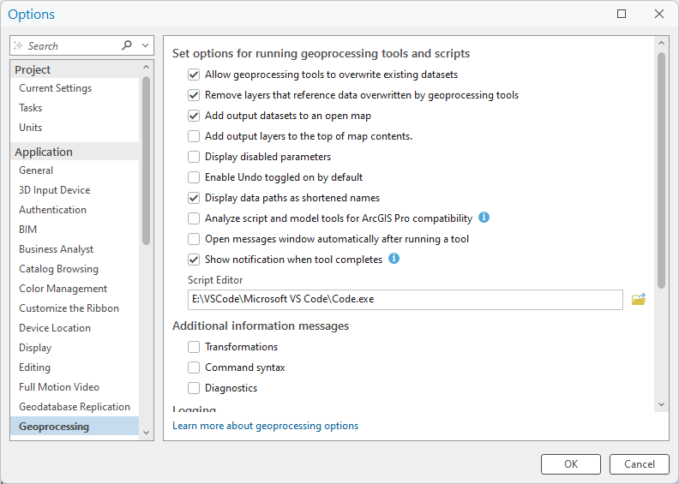

Slide 8
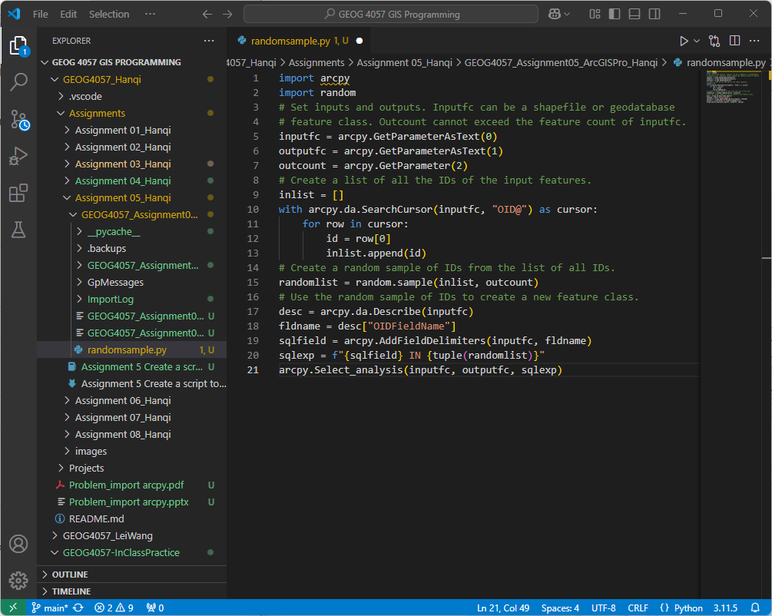

Slide 9
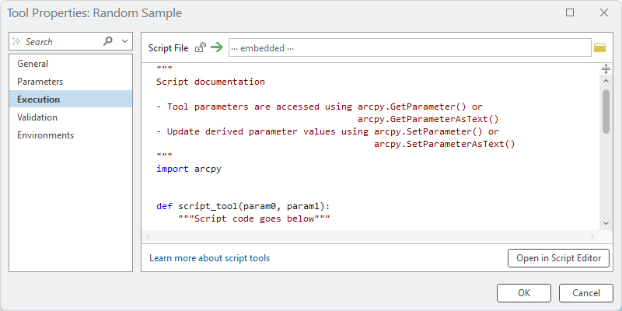

Slide 10
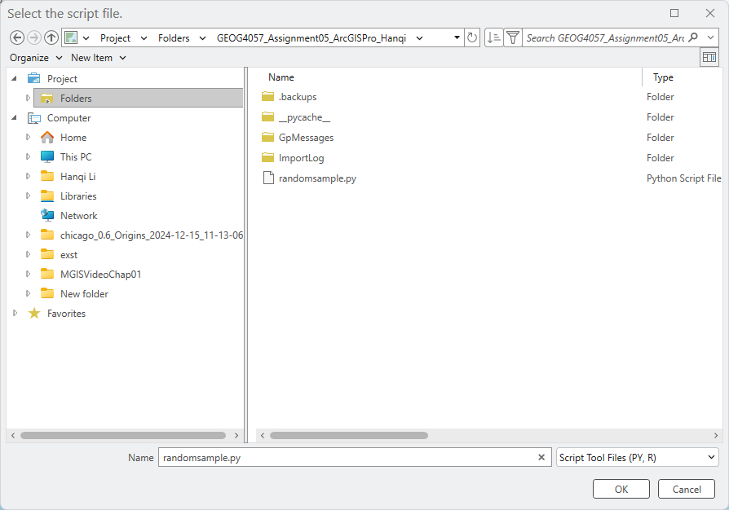

Slide 11
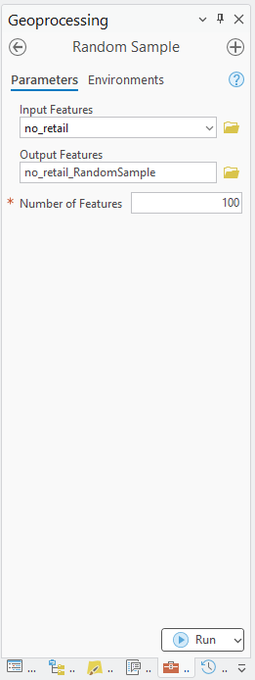

Slide 12
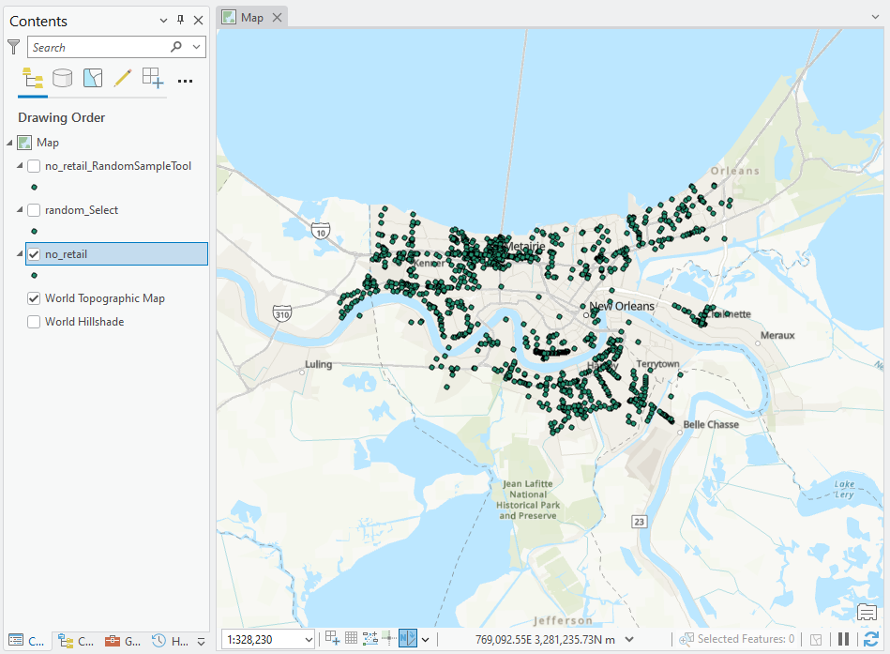

Slide 13
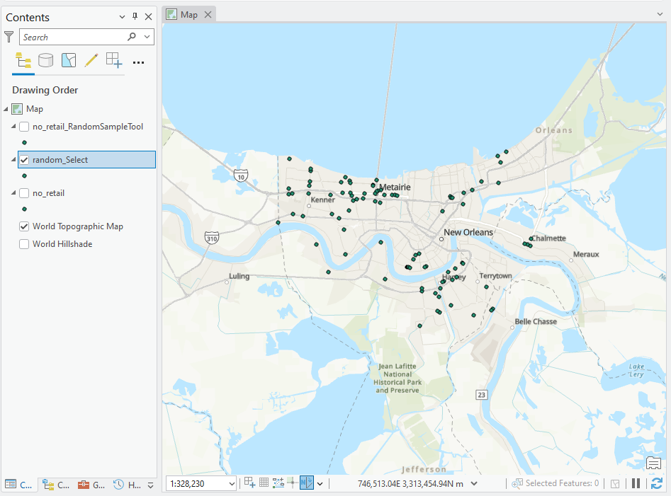

Slide 14
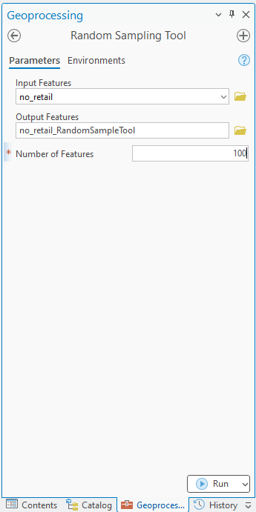

Slide 15
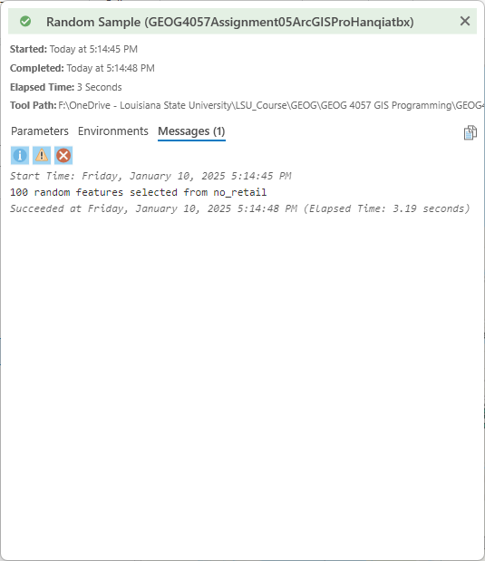
1

Slide 16
Create a python toolbox

Slide 17
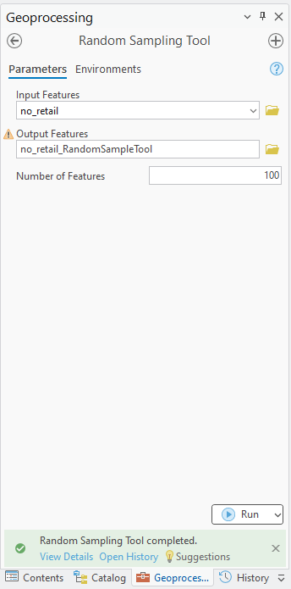

Slide 18
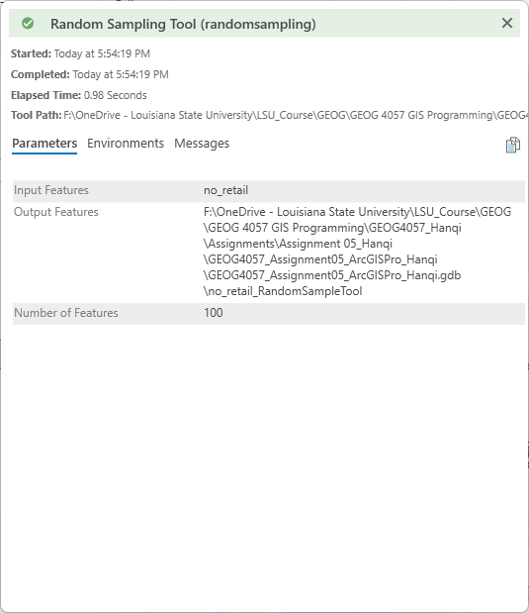
2

Slide 19
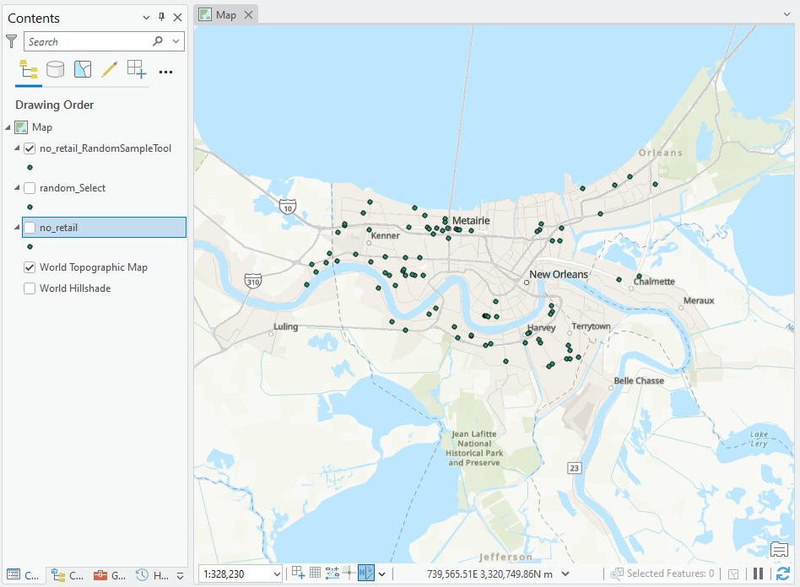

Slide 20
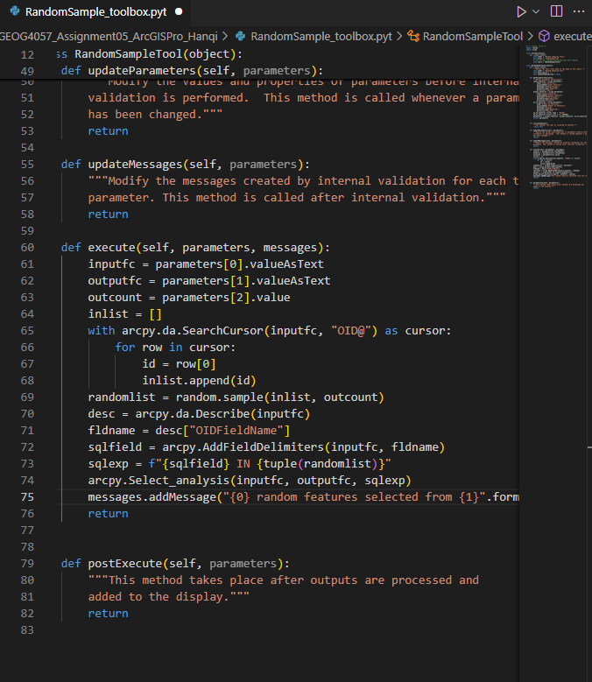

Slide 21
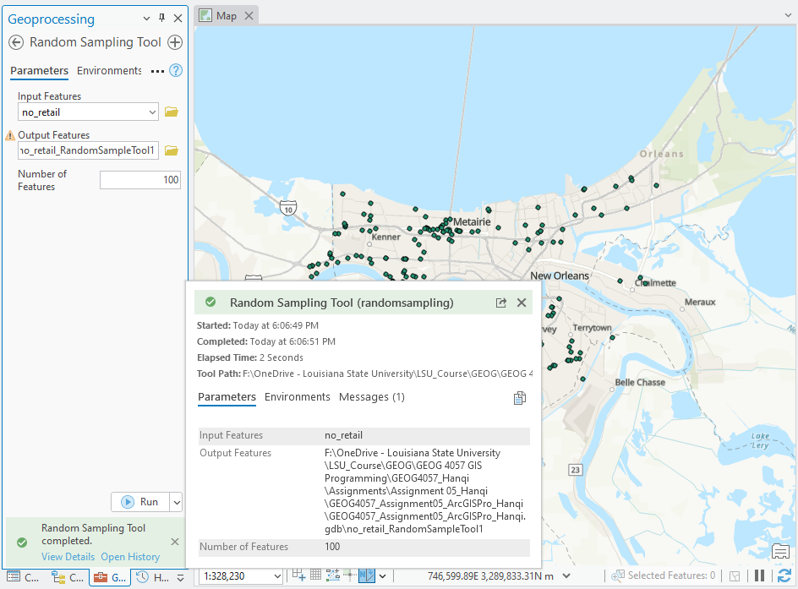

Slide 22
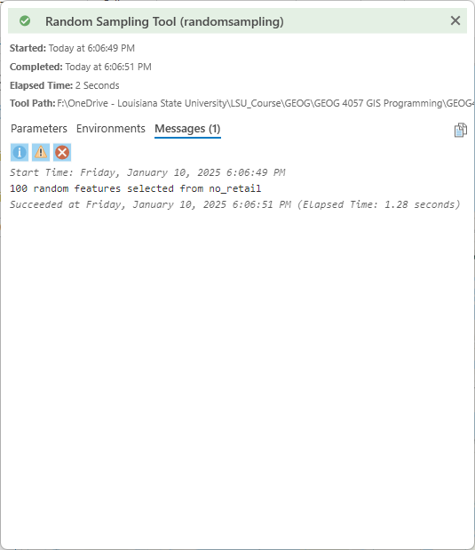

Slide 23
script tool VS python toolbox similarity and differences
The script tool and the Python toolbox in ArcGIS Pro both serve as essential components of the Geoprocessing framework, allowing users to execute custom workflows and automate tasks using Python. My experience with the script tool highlights its straightforwardness and accessibility, especially for those new to Python scripting in ArcGIS Pro. It enables the creation of simple tools by linking a Python script to the geoprocessing framework, where parameters can be defined through an intuitive GUI. This makes it ideal for quick deployment and integration of standalone Python scripts into ArcGIS workflows. However, the script tool has limited customization and flexibility compared to the Python toolbox.
On the other hand, the Python toolbox (pyt) offers a more robust and flexible approach. Unlike the script tool, a Python toolbox is defined entirely in Python, providing greater control over tool behaviors, parameter definitions, and advanced validation logic. In my experience, this makes it particularly useful for developing complex tools or suites of tools that require extensive customization or dynamic interactions between parameters. However, the Python toolbox comes with a steeper learning curve, requiring familiarity with Python classes and ArcGIS-specific Python modules.
In summary, the script tool and Python toolbox share the ability to integrate Python into geoprocessing tasks but differ in complexity and flexibility. The script tool is user-friendly and suited for simple tasks, while the Python toolbox offers advanced customization and is better for complex or dynamic workflows.

